Slide 1

Web Scrapping and Visualization of Ambition Box
By-Vamshi Krishna Datla

Slide 2

Company Profile – AmbitionBox
Ambition Box is a platform focused on helping job seekers make informed career decisions by providing company reviews, salary insights, and interview information. It was founded in 2015 and is now part of Naukri.com. The platform aims to increase workplace transparency and empower job seekers with the information they need to find a fulfilling career.

Slide 3

Problem Statement
The goal of this project is to perform comprehensive exploratory data analysis (EDA) on the Ambition Box dataset, which includes employee reviews, salary data, job roles, company ratings, and other company-specific insights. The analysis aims to uncover patterns and trends in:
Job satisfaction across roles and industries
Salary distribution by company, experience, and job title
Rating trends for top companies and roles
Key factors influencing employee reviews and company ratings

Slide 4
Tools Used
Requests: Used to send HTTP requests to websites and fetch web page content.
Beautiful Soup : Parses HTML/XML documents and extracts specific data.
Pandas: Essential library for data cleaning, wrangling, and exploration.
NumPy:Supports numerical operations and handling arrays.
Matplotlib: Basic plotting library for visualizing data distributions.
Seaborn: Enhances matplotlib with beautiful statistical plots.

Slide 5
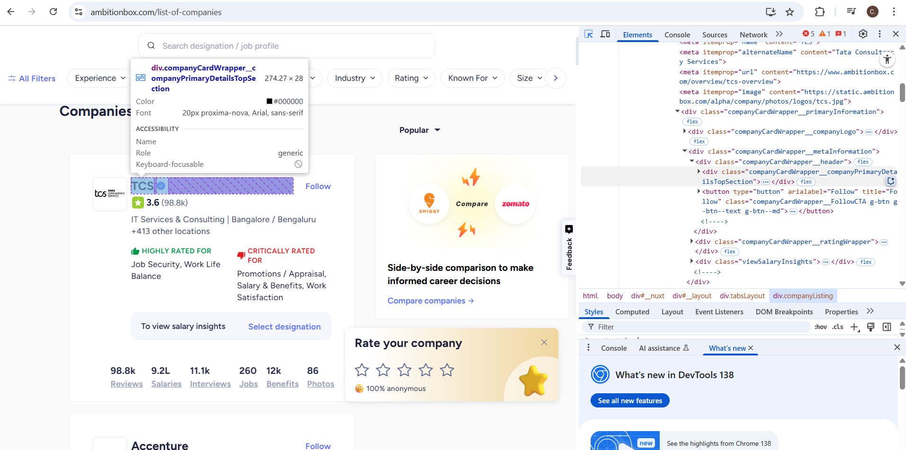
Web Scrapping

Slide 6
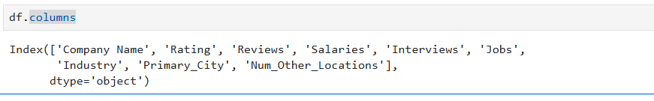
Columns Names
List of Columns In Dataset
Rating – Average company rating from employee reviews
Reviews – Number of employee reviews submitted
Salaries – Number of salary records shared
Interviews – Number of interview experiences posted
Jobs – Number of job listings per company
Num_Other_Locations – Number of other locations a company operates in

Slide 7
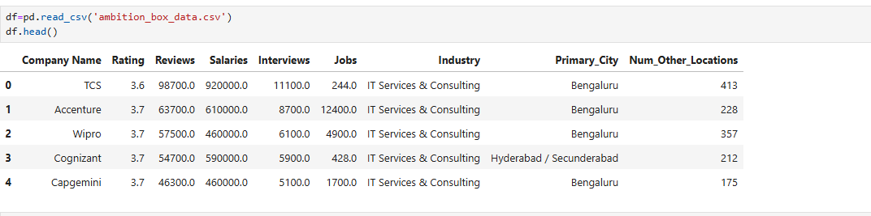
Loding Dataset

Slide 8
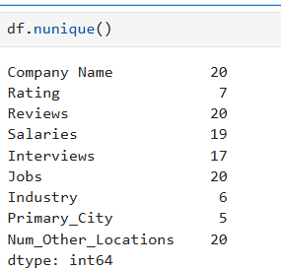
Checking For Unique Values

Slide 9
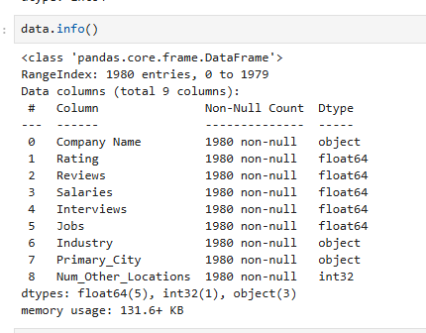
Description Of Data Before Cleaning

Slide 10
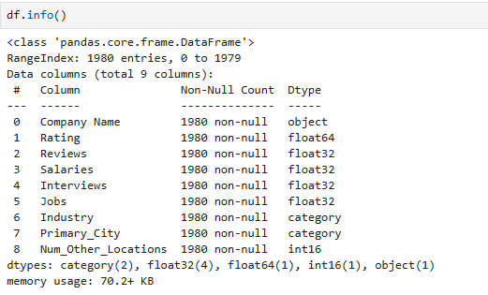
Description Of Data After Cleaning
Steps of data cleaning:
Changing datatypes of different columns to suitable data.
Eg.:df['Industry']=df['Industry'].astype('category’)
Filling null values with nan values.
Eg.:df['Jobs'].fillna(0, inplace=True)

Slide 11
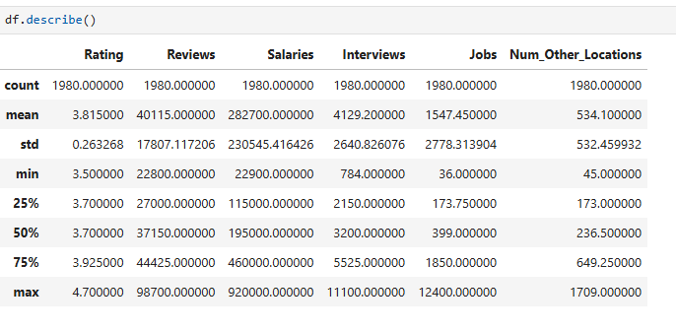
Descriptive Statistics

Slide 12
Descriptive Statistics Summary
Metric | Insight
Rating | Average rating is 3.81, ranging from 3.5 to 4.7. Majority of companies are moderately rated.
Reviews | Companies received 22,800 to 98,700 reviews. Median is 37,150, showing strong employee engagement.
Salaries | Reported salaries range from ₹22,900 to ₹9.2 Lakhs, with a median of ₹1.95 Lakhs, indicating large variability.
Interviews | Interview counts span 784 to 11,100, averaging around 4,129 per company.
Jobs | Active job listings range from 36 to 12,400, with a median of 399, indicating wide hiring differences.
Other Locations | Companies are spread across 45 to 1,709 locations, with an average presence in 534 locations, indicating strong regional diversity.

Slide 13
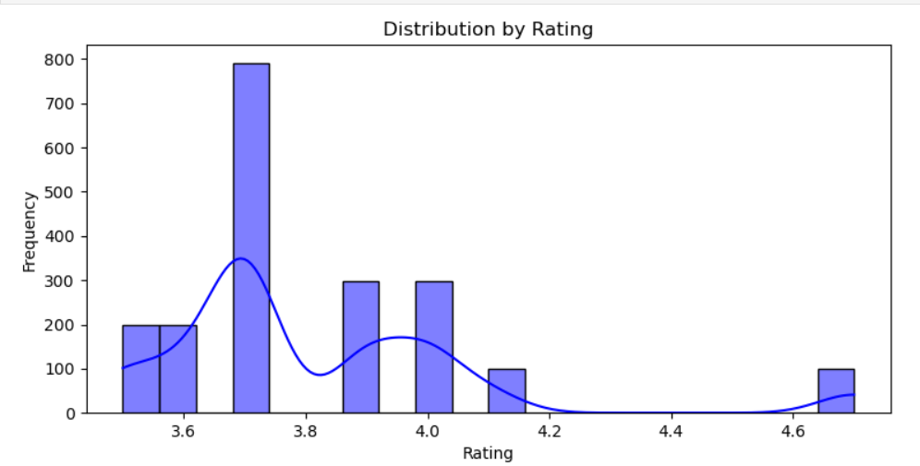
Distribution By Rating
.Distribution By Rating
Most rating fall between 3.6 to 4.1, with a sigificant peak around 3.7-3.8.
Very few ratings go abouve 4.3, indicating ratings are generally modrate.

Slide 14
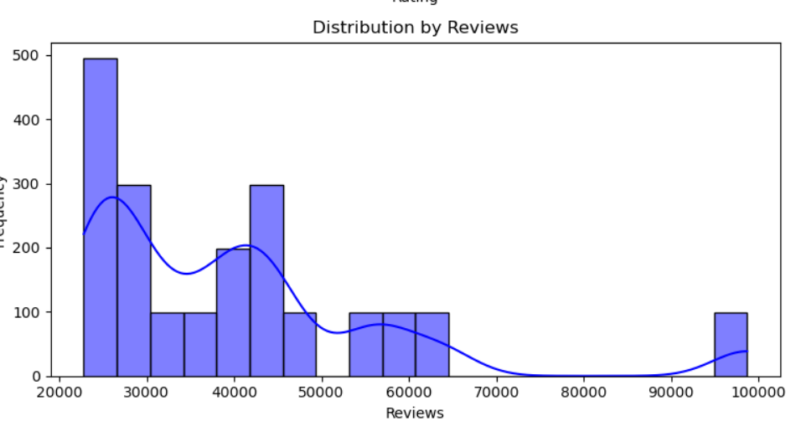
Distribution By Reviews
Distribution By Reviews
Majority of companies having around 20,000 to 50,000 reviews

Slide 15
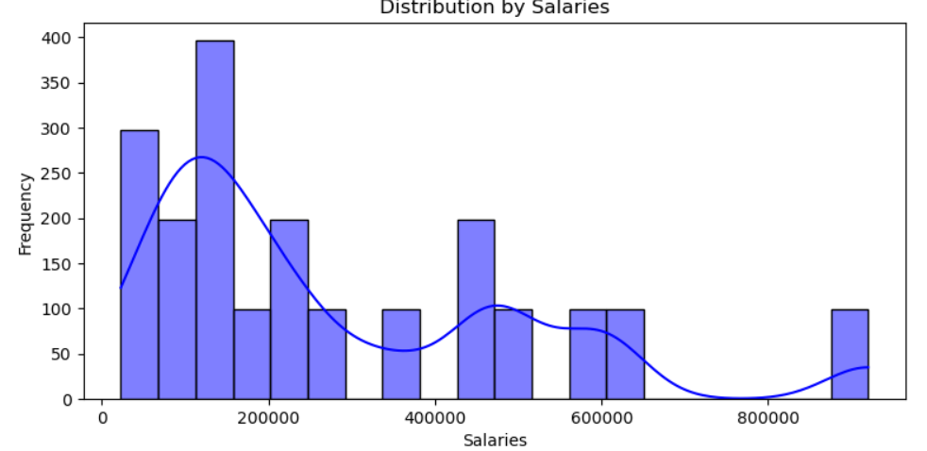
Distribution By Salaries
Distribution By Salaries
Most salaries cluster between 50,000 to 300,000,with several smaller peaks.

Slide 16
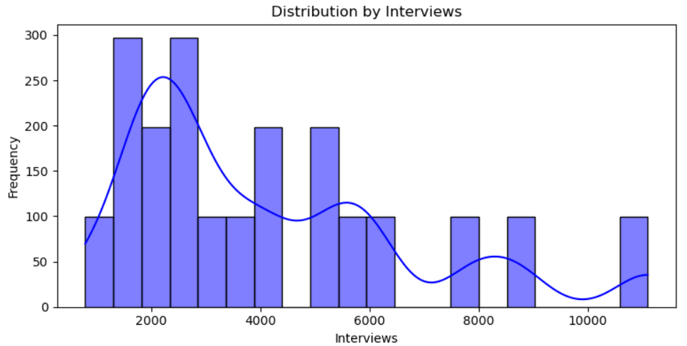
Distribution By Interviews
Distribution By Interviews
Interviews are mostly in the 1,000 to 6,000 range.

Slide 17
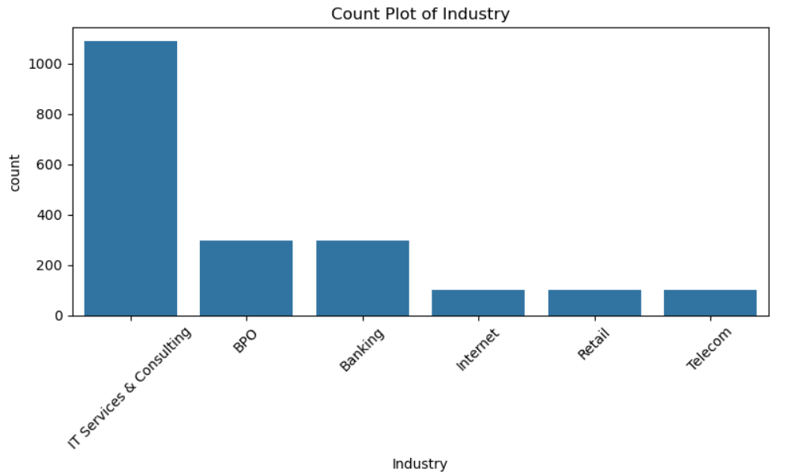
Count Plot of Industry
Count plot of industry
IT services & consulting dominates with the highest count , indicating its the most represented industry in the dataset.
BPO & Banking come next , but with significantly fewer entries.

Slide 18
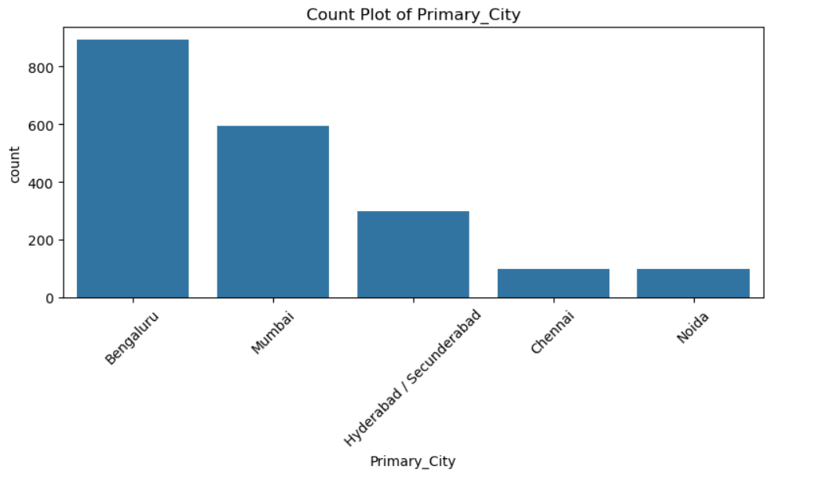
Count Plot of Primary City
Count plot of primary city
Bengaluru leads with the highest number of records , followed by Mumbai and Hyderabad/secunderabad
Chennai & Noida have the lowest counts in this set.

Slide 19
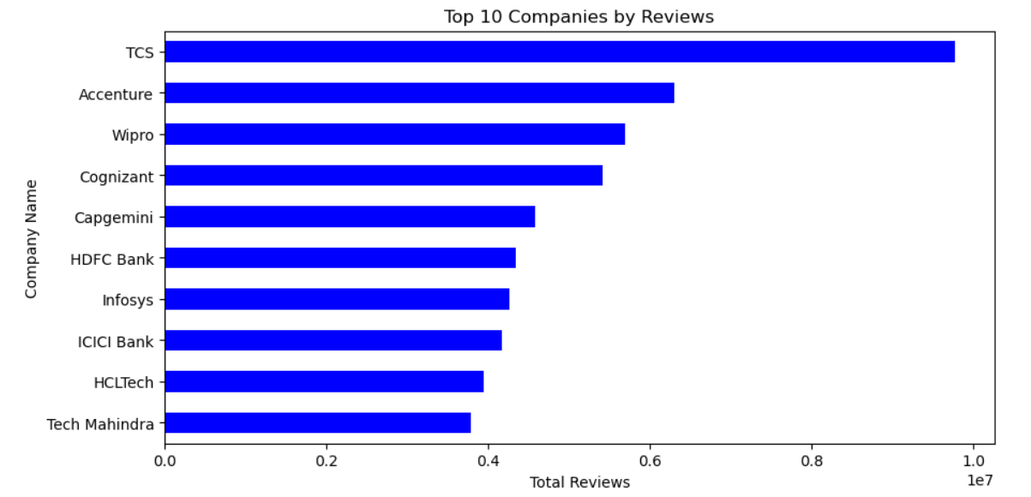
What Are The Top 10 Companies by Reviews?
Observation on Top 10 Companies by Reviews
TCS has highest number of reviews, indicating a large employee base or active participating in review platforms.
Accenture, Wipro & Cognizant follow in terms of reviews count, showing high engagement.
The list includes both IT companies like Infosys,HCL Tech ,Tech Mahindra & Banks are HDFC Bank , ICICI Bank suggesting that job reviews are widespread across industries.

Slide 20
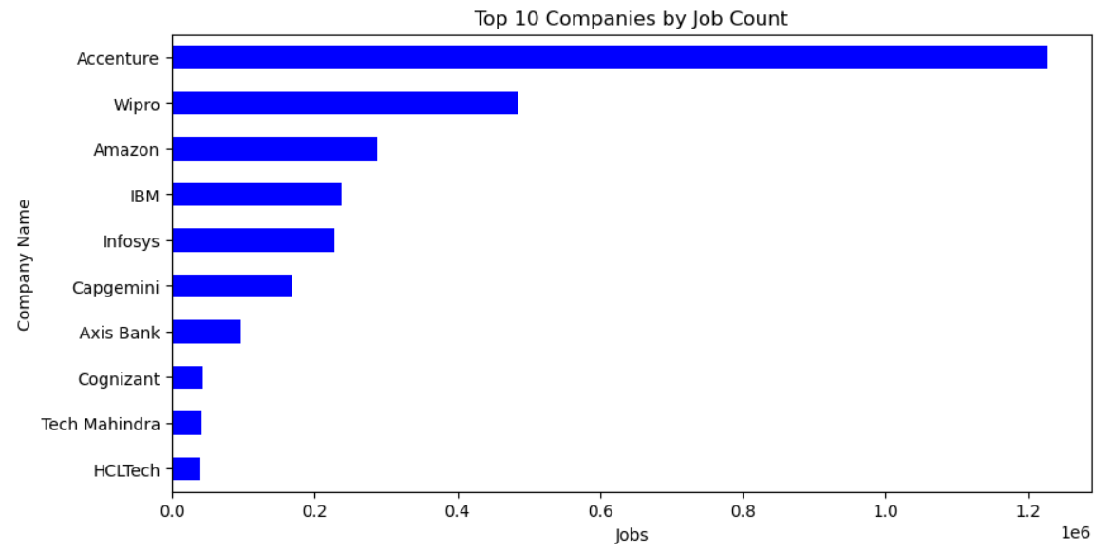
What Are The Top 10 Companies With Number Of Jobs ?
Observation on Top 10 Companies by jobs
Accenture leads by large margin with over 1.2millions job posting it indicating strong demand.
Wipro comes next, followed by Amazon and IBM , showing active recruitment in both IT services.
Other companies with notable job postings including Infosys, Capgemini & AXIS Bank showing that both IT and banking sectors are active.
Cognizant , Tech Mahindra & HCL Tech also made it to the top 10, though with relatively fewer jobs.

Slide 21
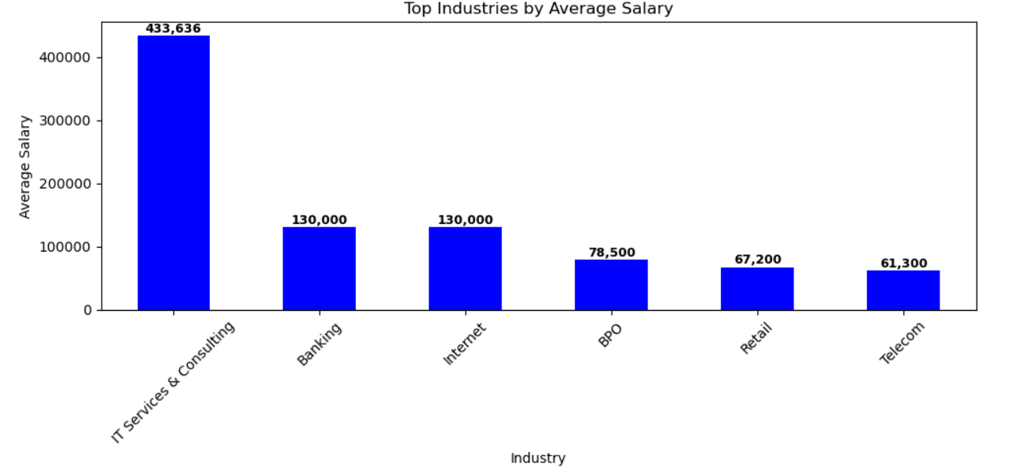
What Are The Top 10 Industries by Average Salary ?
Observation on Top Industries by Average Salary
IT Services & Consulting leads
This industry has the highest average salary by a subnational margin of 433,636.
Banking and Internet industries follows
These two are industries show the next highest average salaries , both falling in the range of 130,000.Much lower than IT Services & consulting.
BPO , Retail & Telecom
have Lower averages salaries.These industries show significantly lower average salaries, all below 100,000 units. With Telecom having lowest among the displayed industries.

Slide 22
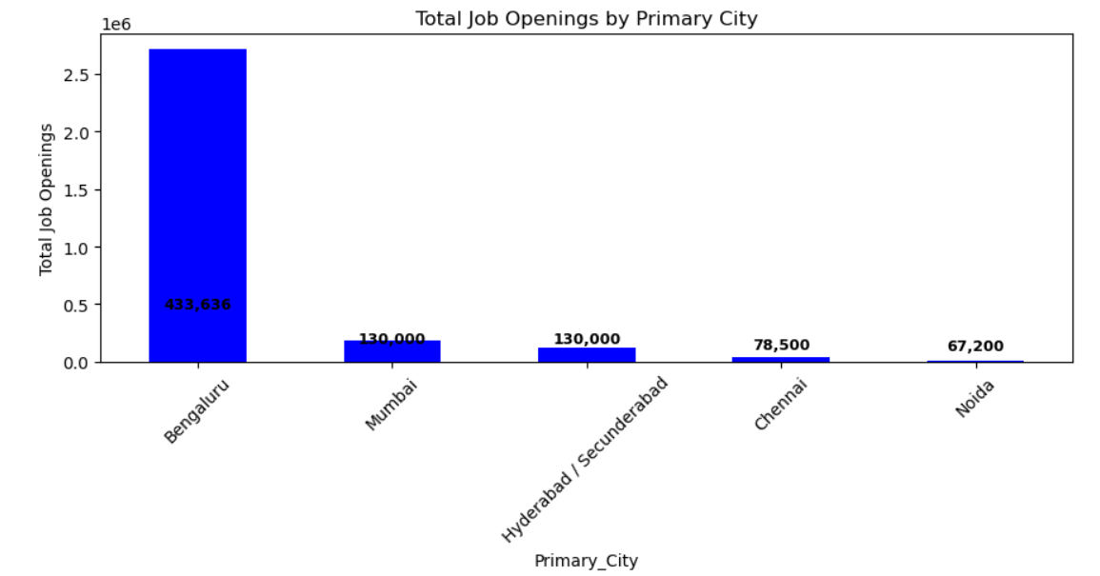
What Are The Total Job Openings by Primary City ?
Observation on Total Job Openings by Primary City
Bengaluru dominates job opening
Bengaluru has a significantly higher number of job openings compared to all other cities,with its bar reaching approximately 2.75 millions opening.
Mumbai & Hyderabad
Mumbai and Hyderabad show the next highest number of jobs opening, but they are dramatically lower than Bengaluru appearing 130000.
Chennai & Noida
There's a very clearly Chennai and Noida are lowest job opening , even have a fewer job openings compared to Mumbai

Slide 23
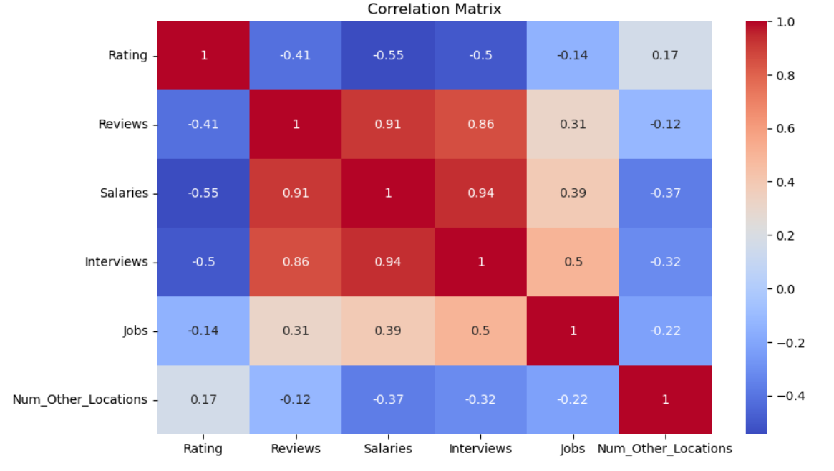
Correlation Matrix
Observations on the correlation matrix:
Strong positive correlations:
Salaries & Interviews: correlation = 0.93, Most interviews are associated with higher salary data.
salaries & Reviews : correlation = 0.91 Companies with more reviews tend to report higher salaries.
Interviews & Reviews: correlation = 0.86 companies with more reviews also have more interviews data.
salaries & jobs: correlation = 0.39 moderate positive relationship: more jobs might relate to higher salary data.
Negative Correlation:
Rating & Salaries: correlation = -0.54 surprisingly, companies with higher salaries tend to lower ratings
Rating & Interviews: correlation = -0.50 companies with more interviews data often receive lower ratings.
Weak Or Negligible Correlation:
Rating & Jobs: correlations = -0.14
num_other_location has weak or negatives with most features.

Slide 24
✅ Conclusion
This analysis of the Ambition Box dataset offered a comprehensive view of job availability, salary trends, and industry dynamics across major Indian cities.
Cities like Bengaluru, Mumbai, and Hyderabad continue to lead India's employment landscape, especially in the technology and services sectors.
The data revealed significant disparities in average salaries across industries, helping identify high-paying sectors and potential career opportunities.
By combining data on location, job roles, and industry sectors, the analysis uncovered meaningful patterns useful for career planning and recruitment strategies.
The project underscores the power of exploratory data analysis (EDA) in deriving actionable insights from real-world employment data.

Slide 25

THANK YOU

